Slide 1
NOSQL-2: CYAEC49 Unit-2

Slide 2
Introduction
The term ‘Big Data’ is used for collections of large datasets that include huge volume, high velocity, and a variety of data that is increasing day by day. Using traditional data management systems, it is difficult to process Big Data. Therefore, the Apache Software Foundation introduced a framework called Hadoop to solve Big Data management and processing challenges.
Hadoop
Hadoop is an open-source framework to store and process Big Data in a distributed environment. It contains two modules, one is MapReduce and another is Hadoop Distributed File System (HDFS).

Slide 3
Introduction
MapReduce: It is a parallel programming model for processing large amounts of structured, semi-structured, and unstructured data on large clusters of commodity hardware.
HDFS:Hadoop Distributed File System is a part of Hadoop framework, used to store and process the datasets. It provides a fault-tolerant file system to run on commodity hardware.
The Hadoop ecosystem contains different sub-projects (tools) such as Sqoop, Pig, and Hive that are used to help Hadoop modules.

Slide 4
Introduction
Sqoop: It is used to import and export data to and from between HDFS and RDBMS.
Pig: It is a procedural language platform used to develop a script for MapReduce operations.
Hive: It is a platform used to develop SQL type scripts to do MapReduce operations.
Note: There are various ways to execute MapReduce operations:
The traditional approach using Java MapReduce program for structured, semi-structured, and unstructured data.
The scripting approach for MapReduce to process structured and semi structured data using Pig.
The Hive Query Language (HiveQL or HQL) for MapReduce to process structured data using Hive.

Slide 5
What is Hive?
Hive is a data warehouse infrastructure tool to process structured data in Hadoop. It resides on top of Hadoop to summarize Big Data, and makes querying and analyzing easy.
Initially Hive was developed by Facebook, later the Apache Software Foundation took it up and developed it further as an open source under the name Apache Hive. It is used by different companies. For example, Amazon uses it in Amazon Elastic MapReduce.
Hive is :
A Data Warehouse Infrastructure → Built on top of Hadoop, Hive enables querying and managing large datasets stored in Hadoop's HDFS.
Optimized for OLAP (Online Analytical Processing) → Hive is designed for analytical queries, batch processing, and large-scale data summarization.
Uses HiveQL (SQL-like Query Language) → Hive provides a SQL-like interface for querying data, making it easier for SQL users to work with big data.
Executes Queries Using MapReduce, Tez, or Spark → Instead of traditional row-level processing, Hive translates queries into distributed computing jobs.
Schema-on-Read → Unlike traditional databases, Hive applies schema at query time rather than at data ingestion.

Slide 6
Features of Hive
Features of Hive
It stores schema in a database and processed data into HDFS.
It is designed for OLAP.
It provides SQL type language for querying called HiveQL or HQL.
It is familiar, fast, scalable, and extensible.

Slide 7
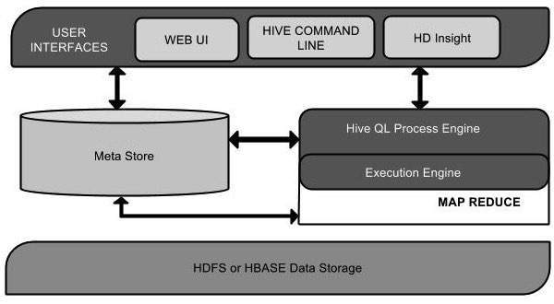
Architecture of Hive
Architecture of Hive
The following component diagram depicts the architecture of Hive:

Slide 8
Architecture of Hive
This component diagram contains different units. The following table describes each unit:
User Interface Hive is a data warehouse infrastructure software that can create interaction between user and HDFS. The user interfaces that Hive supports are Hive Web UI, Hive command line, and Hive HD Insight (In Windows server).
Meta Store Hive chooses respective database servers to store the schema or Metadata of tables, databases, columns in a table, their data types, and HDFS mapping.
HD Insight: Hadoop Distributed Insight.
It provides a managed cloud environment to run Hive, Spark, HBase, and other big data frameworks.
It allows users to execute HiveQL queries and manage data stored in HDFS or HBase.
It supports MapReduce, Tez, and Spark as execution engines.

Slide 9
Architecture of Hive
HiveQL Process Engine HiveQL is similar to SQL for querying on schema info on the Metastore. It is one of the replacements of traditional approach for MapReduce program. Instead of writing MapReduce program in Java, we can write a query for MapReduce job and process it.
Execution Engine The conjunction part of HiveQL process Engine and MapReduce is Hive Execution Engine. Execution engine processes the query and generates results as same as MapReduce results. It uses the flavor of MapReduce.
HDFS or HBASE Hadoop distributed file system or HBASE are the data storage techniques to store data into file system.

Slide 10
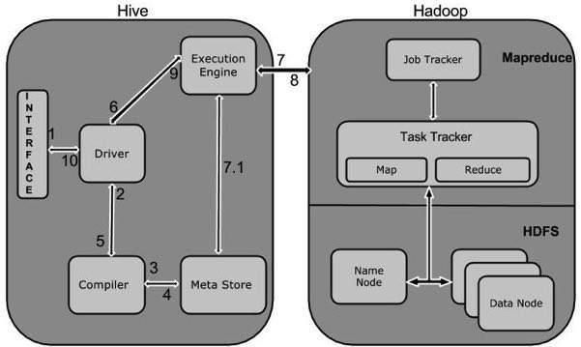
Working of Hive

Slide 11
Working of Hive
The following table defines how Hive interacts with Hadoop framework:
1 Execute Query
The Hive interface such as Command Line or Web UI sends query to Driver (any database driver such as JDBC, ODBC, etc.) to execute.
2 Get Plan
The driver takes the help of query compiler that parses the query to check the syntax and query plan or the requirement of query.

Slide 12
Working of Hive
3 Get Metadata
The compiler sends metadata request to Metastore (any database).
4 Send Metadata
Metastore sends metadata as a response to the compiler.
5 Send Plan
The compiler checks the requirement and resends the plan to the driver. Up to here, the parsing and compiling of a query is complete.
6 Execute Plan
The driver sends the execute plan to the execution engine.

Slide 13
Working of Hive
7. Execute Job
Internally, the process of execution job is a MapReduce job. The execution engine sends the job to JobTracker, which is in Name node and it assigns this job to TaskTracker, which is in Data node. Here, the query executes MapReduce job.
7.1 Metadata Ops
Meanwhile in execution, the execution engine can execute metadata operations with Metastore.
8 Fetch Result
The execution engine receives the results from Data nodes.
9 Send Results
The execution engine sends those resultant values to the driver.
10 Send Results
The driver sends the results to Hive Interfaces.

Slide 14
Installation
All Hadoop sub-projects such as Hive, Pig, and HBase support Linux operating system. Therefore, you need to install any Linux flavored OS. The following simple steps are executed for Hive installation:
Step 1: Verifying JAVA Installation
Java must be installed on your system before installing Hive. Let us verify java installation using the following command:
$ java –version

Slide 15
Installation
wget https://archive.apache.org/dist/hive/hive-3.1.2/apache-hive-3.1.2-bin.tar.gz
tar -xvzf apache-hive-3.1.2-bin.tar.gz
go to path rename apache hive folder to hive
cd /home/hadoop/hive
vim ~/.bashrc
at the end of the file append these lines
export HIVE_HOME=/opt/hive
export PATH=$PATH:$HIVE_HOME/bin
export HADOOP_USER_CLASSPATH_FIRST=true
source ~/.bashrc
cd conf
ls
go to path /home/hadoop/hive rename env.sh

Slide 16
Installation
export HADOOP_HOME=/home/hadoop/hadoop
next go to hive path
export HIVE_CONF_DIR=/opt/hive/conf
In mysql:sudo mysql -u root -p password:mysql
CREATE USER 'hive'@'localhost' IDENTIFIED BY 'Hive@1234';
create database metastore;
GRANT ALL PRIVILEGES ON metastore.* TO 'hive'@'localhost';
FLUSH PRIVILEGES;
exit;

Slide 17
Hive Queries
hive> show databases;
OK
default
Time taken: 0.223 seconds, Fetched: 1 row(s)
hive> CREATE DATABASE my_database;
OK
Time taken: 0.056 seconds
hive> USE my_database;
OK
Time taken: 0.016 seconds

Slide 18
Hive Queries
hive> CREATE TABLE employees (
> id INT,
> name STRING,
> age INT,
> department STRING )
> ROW FORMAT DELIMITED
> FIELDS TERMINATED BY ','
> STORED AS TEXTFILE;
OK
Time taken: 0.198 seconds

Slide 19
Hive Queries
hive> SHOW TABLES;
OK
employees
Time taken: 0.015 seconds, Fetched: 1 row(s)
hive> SELECT * FROM employees;
OK
Time taken: 0.494 seconds
hive> SELECT * FROM employees WHERE age > 30;
OK
Time taken: 0.182 seconds

Slide 20
Hive Queries
hive> SELECT department, COUNT(*) AS total_employees
> FROM employees
> GROUP BY department;
Query ID = hadoop_20250401140950_6d586696-4fef-44b8-b1a4-7d9771211e2b
Total jobs = 1
Launching Job 1 out of 1
Number of reduce tasks not specified. Estimated from input data size: 1
In order to change the average load for a reducer (in bytes):
set hive.exec.reducers.bytes.per.reducer=<number>
In order to limit the maximum number of reducers:
set hive.exec.reducers.max=<number>
In order to set a constant number of reducers:

Slide 21
Hive Queries
set mapreduce.job.reduces=<number>
Starting Job = job_1743494163839_0001, Tracking URL = http://ritadmin:8088/proxy/application_1743494163839_0001/
Kill Command = /home/hadoop/hadoop/bin/mapred job -kill job_1743494163839_0001
Hadoop job information for Stage-1: number of mappers: 0; number of reducers: 1
2025-04-01 14:09:57,429 Stage-1 map = 0%, reduce = 0%
2025-04-01 14:10:01,504 Stage-1 map = 0%, reduce = 100%, Cumulative CPU 1.05 sec
MapReduce Total cumulative CPU time: 1 seconds 50 msec
Ended Job = job_1743494163839_0001
MapReduce Jobs Launched:
Stage-Stage-1: Reduce: 1 Cumulative CPU: 1.05 sec HDFS Read: 6575 HDFS Write: 87 SUCCESS
Total MapReduce CPU Time Spent: 1 seconds 50 msec
OK
Time taken: 12.355 seconds

Slide 22
Hive Queries
hive> SHOW TABLES;
OK
employees
Time taken: 0.013 seconds, Fetched: 1 row(s)
hive> SHOW TABLES;
OK
employees
Time taken: 0.012 seconds, Fetched: 1 row(s)
hive>

Slide 23


